Slide 1


CUDA
Digital HUB

Slide 2

Agenda
Relationship ( CPU , GPU) .
CUDA uses .
Host v.s Device
GPU Mapping
Scalability
Cuda lib in python

Slide 3
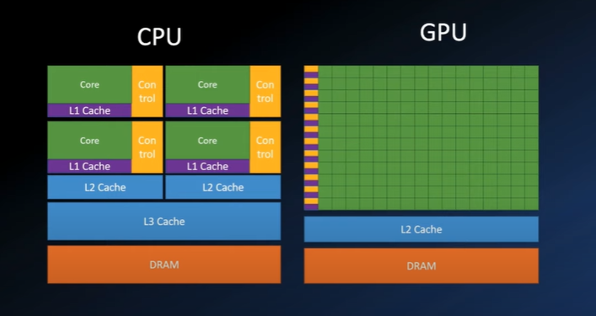
Relationship ( CPU , GPU)

Slide 4
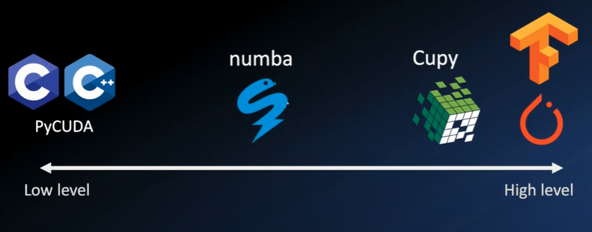
CUDA uses

Slide 5

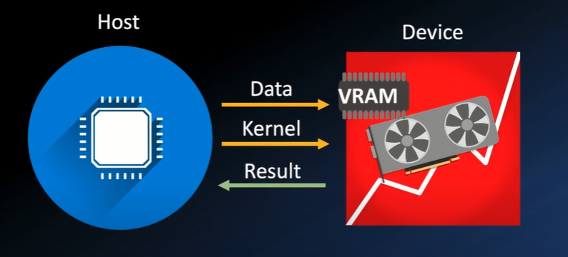
Host v.s Device
In CUDA
the host refers to the CPU and its memory
the device refers to the GPU and its memory

Slide 6

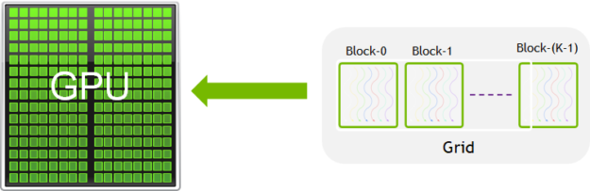
GPU Mapping
Grid
Blocks
Threads
Kernel executes in a thread .
Threads grouped into Thread Blocks (a.k.a. Blocks)
Blocks grouped into Grids
Kernel executed as a Grid of Blocks of Threads

Slide 7
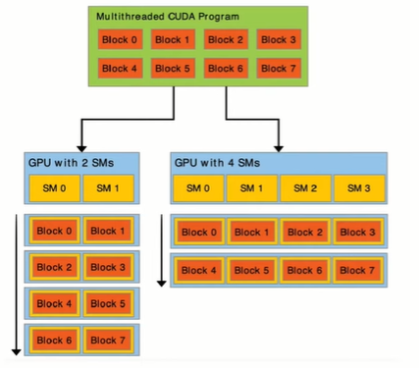
Scalability
1. CUDA program has eight blocks.
2. CUDA run-time allocate sblocks to streaming multiprocessors (SMs) .
Small GPU (two SMs): each SM gets two blocks
Larger GPU (four SMs): each SM gets one block
Scalability without code changes!

Slide 8
Scalability
1.CUDA scales with increasing number of cores (SPs in SMs)
2. Program using CUDA language abstractions
3. Divide into sub-problems, solved independently by thread blocks.
4. Each block solves one sub-problem in parallel threads (running a kernel).
5. CUDA runtime schedules blocks on multiprocessors
6. Scheduling can be done in any order
►Allows program to scale to any number of multiprocessors.
► Kernel code can't rely on sequencing

Slide 9
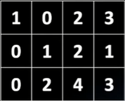
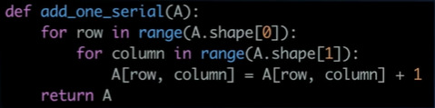
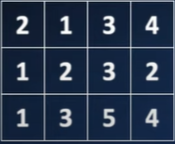
If I need add 1 to each cell ( CPU )
A
In CPU
A

Slide 10
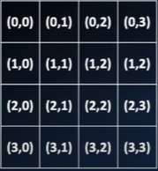
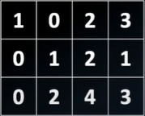
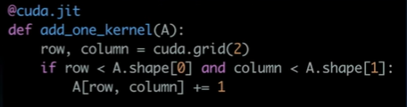
If I need add 1 to each cell ( GPU )
A
A
grid

Slide 11
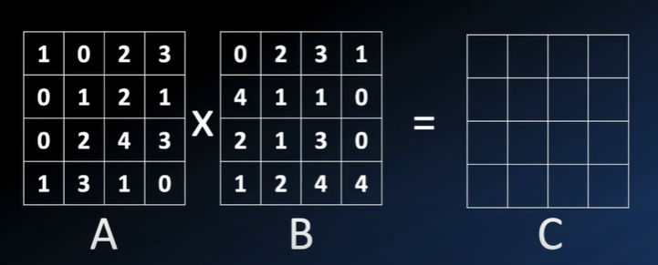
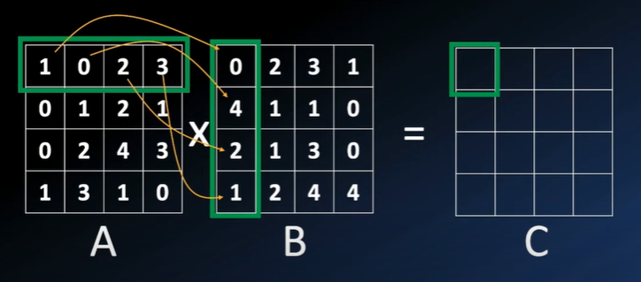
If you need A*B in CPU

Slide 12
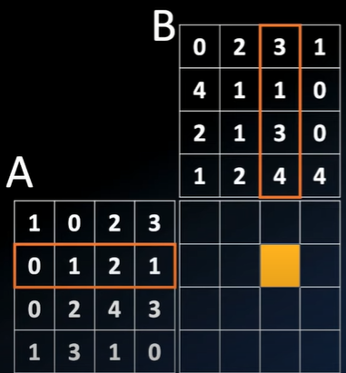
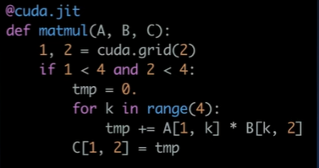
If you need A*B in GPU
Local Memory
(i , j)=(1 , 2)
C = Grid

Slide 13
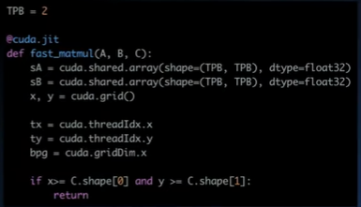
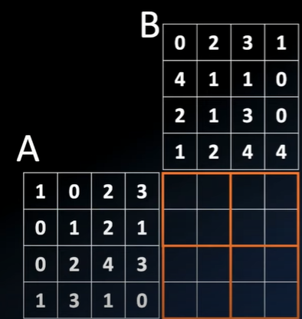


For Blocks
N
sA
sB

Slide 14
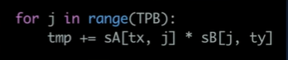
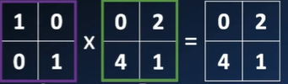
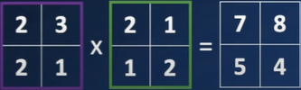
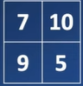
For Blocks 1
i=0
i=1
+
N

Slide 15


Cuda lib in python
Nampa
Cupyand Numpa notebok
NLP Project notebok

Slide 16
references
https://numba.pydata.org/numba-doc/latest/cuda/index.html
https://stackoverflow.com/questions/60027446/how-to-run-python-on-gpu-with-cupy

Slide 17
Questions ?

Slide 18
THANKS
Do you have any questions?
Ahmed.sakr151997@gmail.com
+20 1018191872
linkedin.com/in/ahmed--sakr/

